Slide 1

Modern Public Relations
Md. Sabur Khan, Chairman, Daffodil International University

Slide 2

Develop and maintain
sustainable relation
with others for mutual benefit

Slide 3
Public relations is the
mouth of the Organization

Slide 4
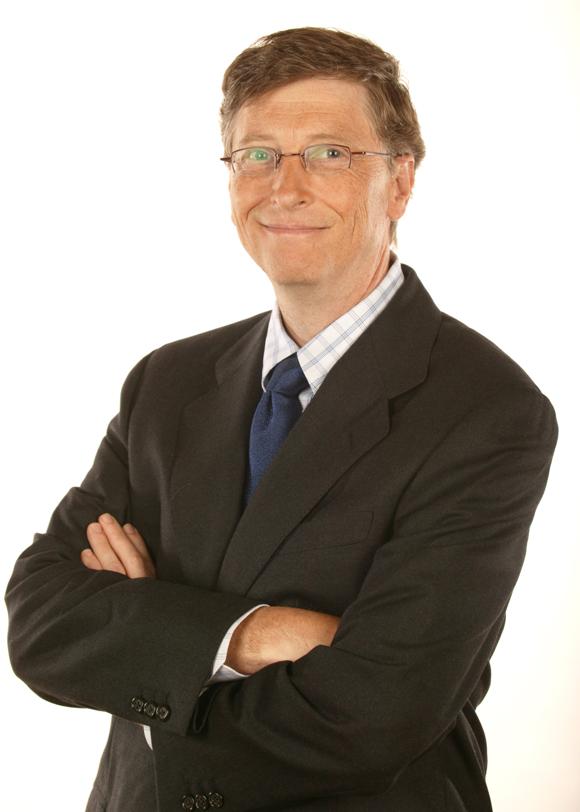
Importance of Public relations in an organization
If I was down to my last dollar, I would spend it on public relations
Bill Gates
Chairman, Microsoft.

Slide 5


Society
News
Message
Media
Organization
PR
Publicity
Communication
Audiences
Social
Advertising

Slide 6

Functions of PR
Internal communication
Branding & Marketing
External Communication
Seeking New Opportunity
Mutual
Benefit
Competitor Analysis

Slide 7

Integrated Marketing Strategy
Social Share

Slide 8
Evaluation
Research
04
01
03
Action
Communication
02
Matron’s RACE Model

Slide 9

Traditional vs Digital Public Relations
Newspaper Advertisement
Radio/TV Ad
Billboard
Face to Face
Leaflet

Slide 10
Tips to become successful in Digital Public Relation

Slide 11

Know the pulse of stakeholders of your organization and act accordingly

Slide 12


Slide 13
Video: She Sings For Her Dying Dad... Don't Cry
View: 11,224,321
Learning:
How the girl took other attention by her song which touched everybody

Slide 14

Digitalize...
Brand Marketing
Content Marketing
Social Media
Search Engine Optimization

Slide 15


Slide 16

Stay True to Yourself
No Matter Where the World Is

Slide 17
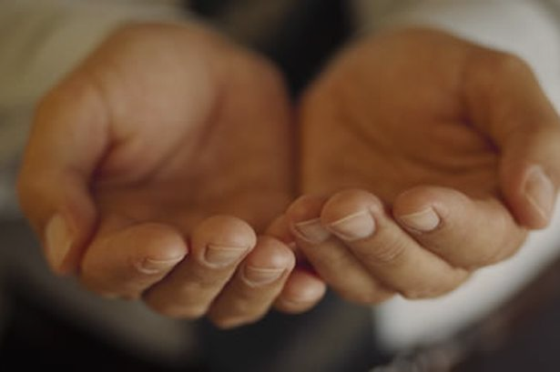
Give Your Learning back to the society
Give Back

Slide 18


Know the global trends and
act accordingly

Slide 19

Modern Technology Adaptation

Slide 20

What do you see?
Faces of 12 Indian Leaders

Slide 21

Be Data Driven
How much data you have &
How tactfully you use those

Slide 22

Competitive Analysis and React

Slide 23

Measure your Reach

Slide 24

Think Different from Others

Slide 25
Make a Guess
Where it is?

Slide 26
You don’t know which click of you will click your career !!!

Slide 27
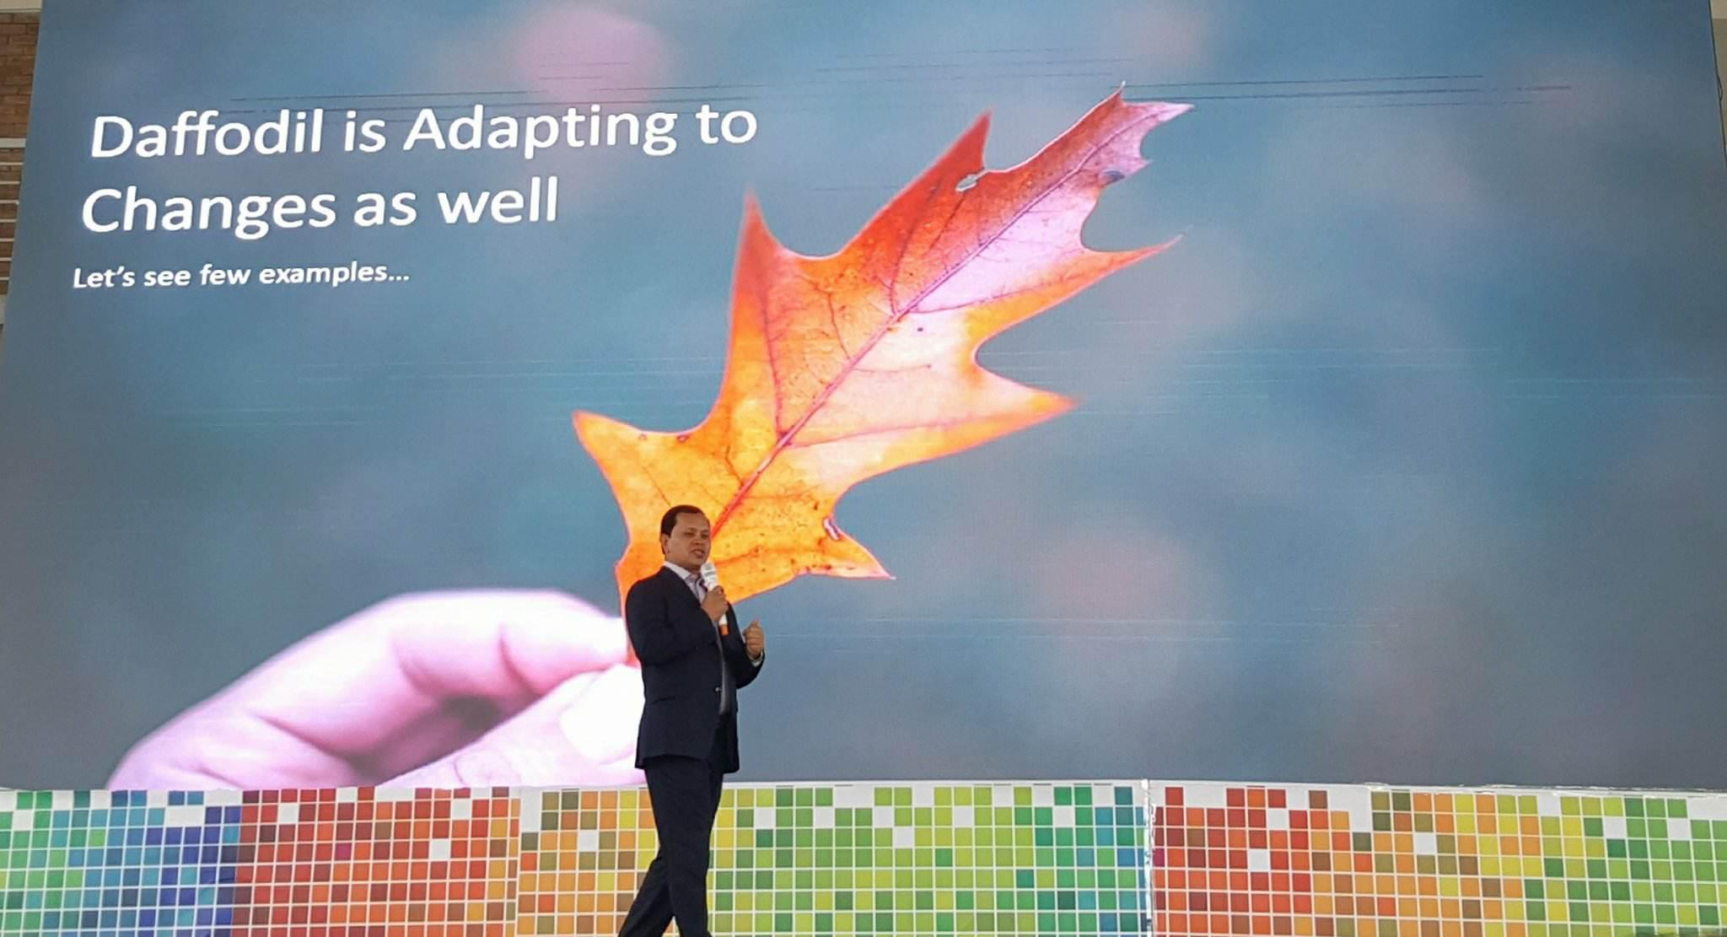
Picture clicked from cell phone from far distance but clicked in right time where picture carry the message

Slide 28
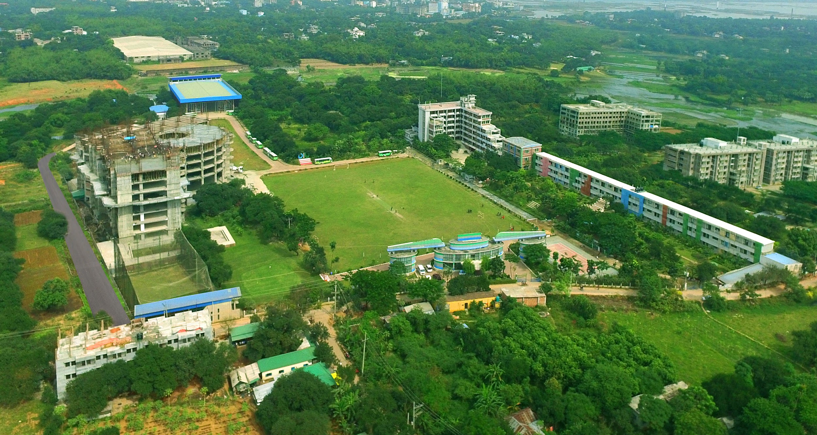
Birds Eye View of
DIU Permanent Campus

Slide 29
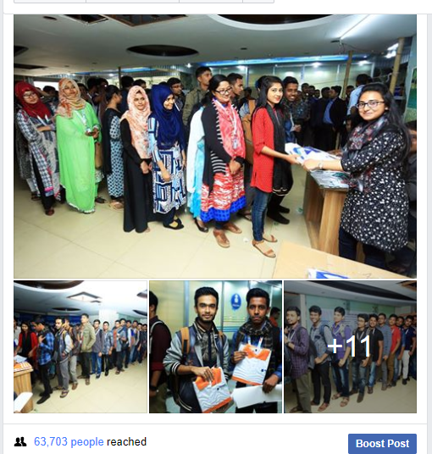
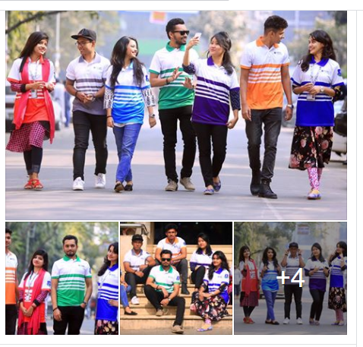
Turned to positive from negative
Post reached in 2 Hours: …
Know your audience/viewers
Post reached in 18 Hours: 63,703

Slide 30

Work Delegation based on team expertise

Slide 31

Earn confidence and trust of Others
by your positive works

Slide 32
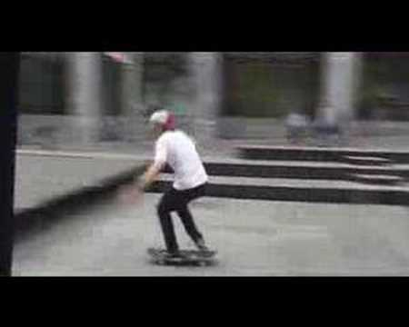

Slide 33
Video: Free Hugs Campaign - Official Page
View: 77,991,073 views
Learning:
Any campaign can create a good impact if you are serious
Any obstacle also u can overcome when you are serious and positive

Slide 34
Title Matters
Topics and Title bring the attention

Slide 35

What would be a great news title for Akij Group?

Slide 36

Follow strategy and
Win the Mind Game

Slide 37

Relationship and Networking

Slide 38

Think out of the box

Slide 39


Slide 40
Video: Stand By Me
View: 109,302,093
Learning:
Playing For Change is a movement created to inspire and connect the world through music.
Any Music by anyone can be a great campaign and get huge attention

Slide 41
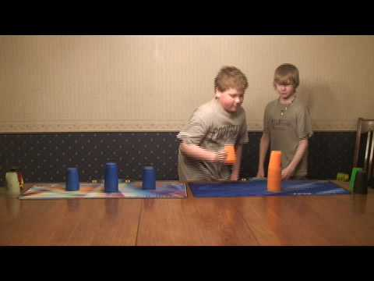

Slide 42
Video: Stacking Routine
View: 622,461
Learning:
They started with a funny way to bring attention

Slide 43
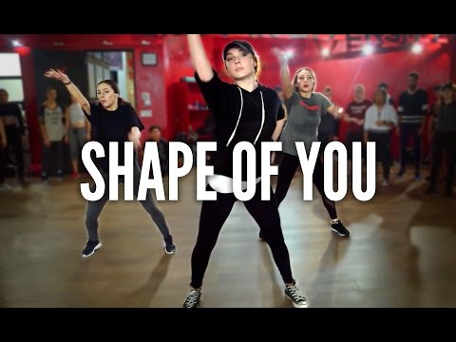

Slide 44
Video: Shape Of You
View: 131,113,758
Learning:
Very simple work did from heart but caught huge attention
Your fun and exercise can get mass attention without any money

Slide 45

Think from readers view make it interesting

Slide 46

​Creativity is Key

Slide 47

Newsworthy
Timely. Important. Interesting

Slide 48



Daffodil Family is looking for
creative PR Executive
from the students

Slide 49

Student Activities
Alumni Success
Faculty Strength
Research
Int. Exposure
Focus

Slide 50

Confident to Overcome the Challenge ???
Come forward

Slide 51
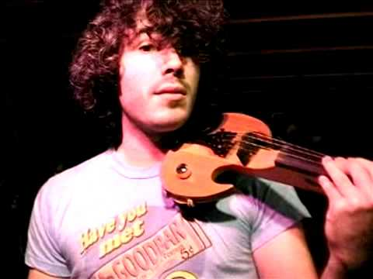

Slide 52
Video: Join the YouTube Symphony Orchestra 2009
View: 1,874,269
Learning:
When you will come to join Daffodil Family in 2018 you need to develop yourself by 2018 and show the glimpse of 2030...
But if you follow 2009 that means still you are in same line where education system are lying

Slide 53
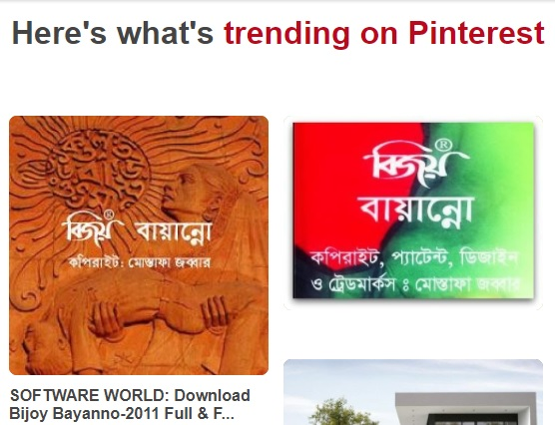

Catch the right time and platform to pass your message to get
mass attraction

Slide 54
Let’s See some example of Marketing Strategy of Nike

Slide 55
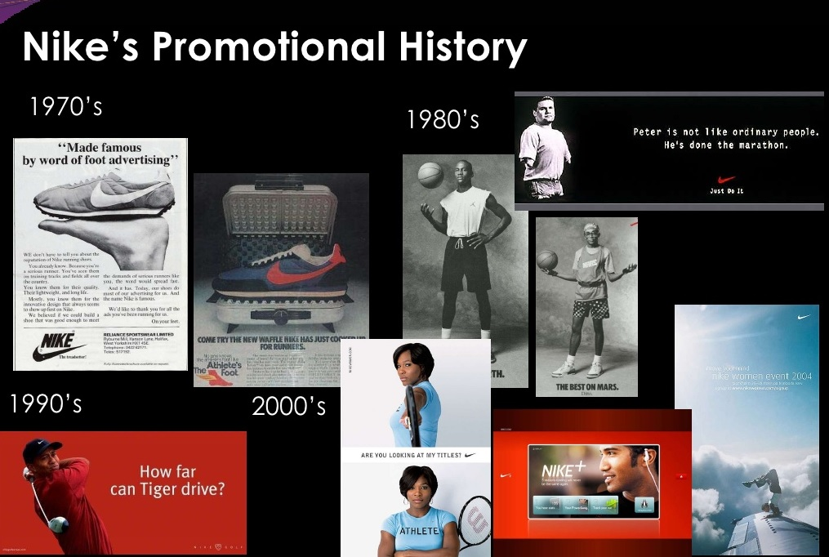
Source: https://www.slideshare.net/Angad00/final-nike

Slide 56
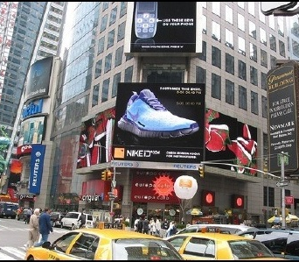
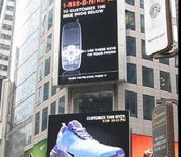
Nike’s Branding Example

Slide 57
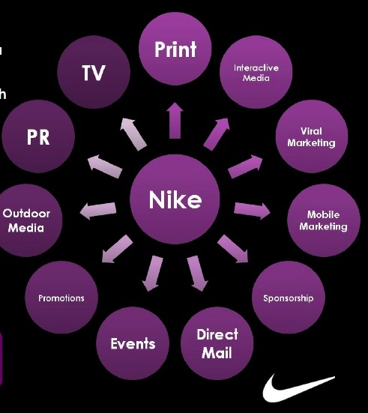
Digital PR Strategy of Nike

Slide 58
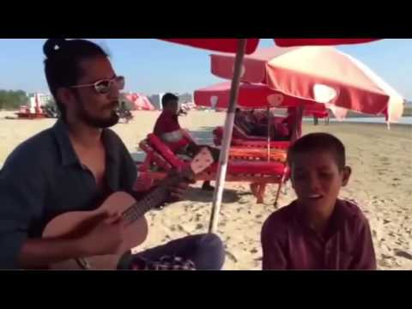

Slide 59
Share your thought about the video

Slide 60
Thanks!
Questions?

Slide 61
References
https://www.youtube.com/watch?time_continue=17
https://www.youtube.com/watch?v=vr3x_RRJdd4
https://www.youtube.com/watch?v=VHjiblrKDQA
https://www.slideshare.net/Angad00/final-nike
https://www.youtube.com/watch?v=Kl5B6MBAntI
https://www.youtube.com/watch?v=-T_SryRAXuw
https://www.pinterest.com
Disclaimer
The content used in this document is prepared for general information and educational purpose and for internal use only. None of these contents will be used for any commercial purpose. This document contains some external links and materials of which we claim no copyright and all the external contents are properly credited by giving the original source link. If any content creator feels that his/her content is used without a proper credit here in this site, please email to info@daffodilvarsity.edu.bd and we will modify it accordingly. Daffodil International University, however, hold right over rest of the contents which should not be used in any commercial platform.

Slide 62
Take Away

